Slide 1
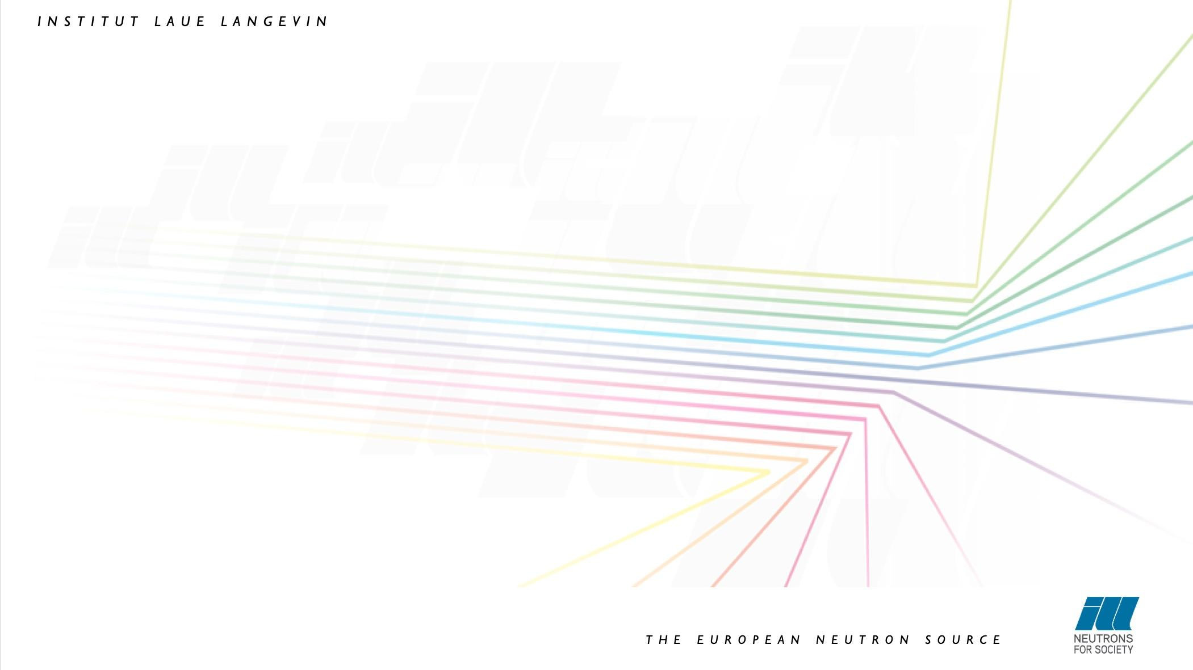
VISA
Virtual Infrastructure for Scientific Analysis
18 June 2020

Slide 2
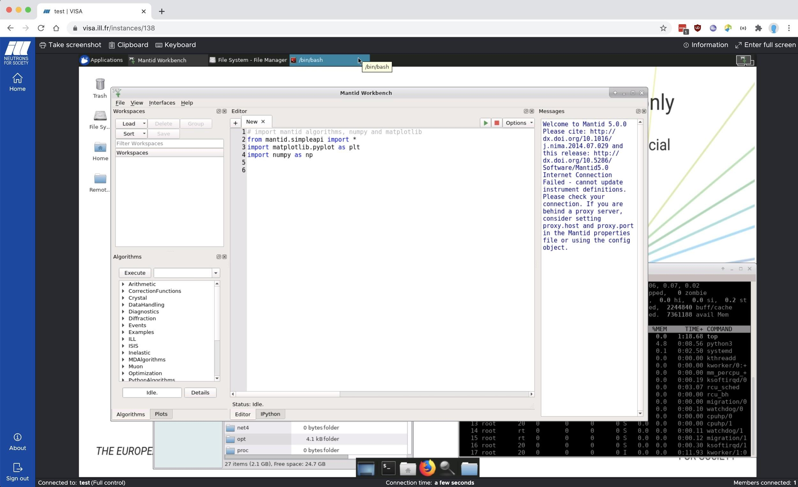
Outline
Objectives
Features
Technical choices and architecture
Image creation
Automated login
Monitoring
Status and future development
Demo

Slide 3

Objectives
Provide remote data analysis services with access to
Experimental data
Analysis software
Compute infrastructure
Support (IT and Scientific)
Make access as simple as possible using a web browser
Remote desktop as if the user was sitting in front of an ILL data treatment workstation
Easy and flexible machine management
Allow scientific collaborations
Sharing desktops
Enable remote experiments
Access Nomad (SCI) to perform instrument control
This is the current priority for the next reactor cycle (August)

Slide 4
Features
Creation and deletion of linux machines (Ubuntu 18.04)
User can choose from predefined flavours (CPU & RAM)
Scientific software is already pre-installed
Remote Desktop via a browser
Apache Guacamole proxying of RDP via socket.io
Sharing machines with other users
Enable scientific collaborations
Allow for scientific support (all ILL scientists can access instances)
On screen keyboard and clipboard integration
OpenID Connect authentication
Provided by Keycloak (login.ill.fr)
Machine lifetime management
Automatic deletion after 14 days or 4 days of inactivity
Externally accessible at https://visa.ill.fr

Slide 5
Technical choices
Virtual Machines on OpenStack
API to manage instances, images, flavours and security groups
Managed by NDS
XRDP for access to remote desktop
Other protocols were evaluated (SPICE, NoVNC etc.)
Apache Guacamole
Converts RDP (and VNC, SSH) into a common protocol (guacd process on the instance)
Bridges a web application to guacd server
Translates TCP socket messages to websocket messages
Java server
REST/GraphQL API
Web-socket (socket.io)
Single page web application (Angular 6)

Slide 6
Logical architecture
Token creation
VISA
OpenStack
Web Application
Angular6
Linux VM
Linux VM
Keycloak
OpenID Connect
Linux VM
RDP /
guacd
Instance Management
REST API
Remote Desktop Access
Socket.io
Token validation
Instance
management
Session authorisation and
Session management
REST API
Business logic
DB

Slide 7


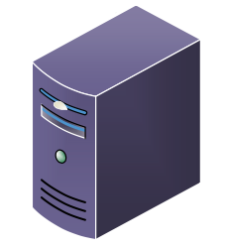
System architecture
OpenStack Controller nodes
VMware
Internet
OS mgmt. network
Srv network
API calls
Deploys and configure via Ansible
EPN firewall
oscloud.ill.fr
osdeploy
manage
VMware
OpenStack Compute nodes
SRV network
Srv network
visaprod
Monitors
visamon
guacamole
visa-db-prod
visa-prod
VISA-INSTANCE-XXX
VISA-INSTANCE-YYY

Slide 8
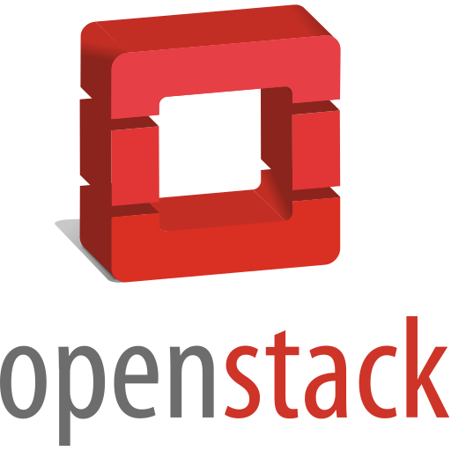
Cloud resources
Provided by OpenStack
Managed by NDS
Three namespaces available
Production, staging and development
Firewall rules minimise access from VMs to other ILL resources
Current capacity
456 cores
2.6TB RAM
Purchasing more performant servers before the next reactor cycle
In view of remote experiments using the VISA platform

Slide 9
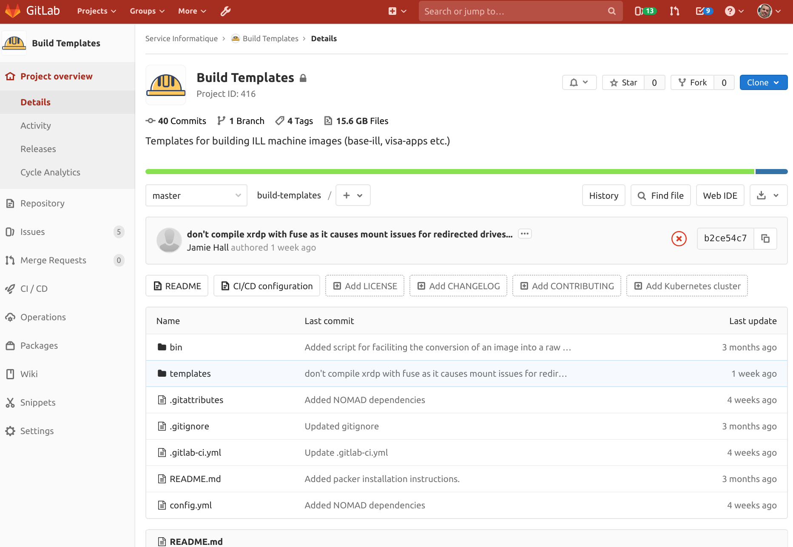
Image creation
Automated (scripted) process
Using packer to build the image
Build from scratch using a base ubuntu installer
Allows for versioning of images
Configuration is stored inside a GIT repository
Each new release is tagged
Nightly builds (in progress)
Linux security updates applied every day
Continuous Integration pipeline
Configured to install scientific software
Matlab, MANTID, LAMP etc.

Slide 10

Automated login to VM
Avoid having to login to both VISA application and VISA instance
User does not have to provide login data to access the VM
Development of a PAM module
Linux Pluggable Authentication Module
Token-based login
Developed in C
Token contains username and expiration time
Cryptographically signed in VISA server (private key)
Validated in the instance using public key
Public key added to image in creation process
Verifies also that the token has not expired and has not been modified
Only applies to XRDP sessions

Slide 11
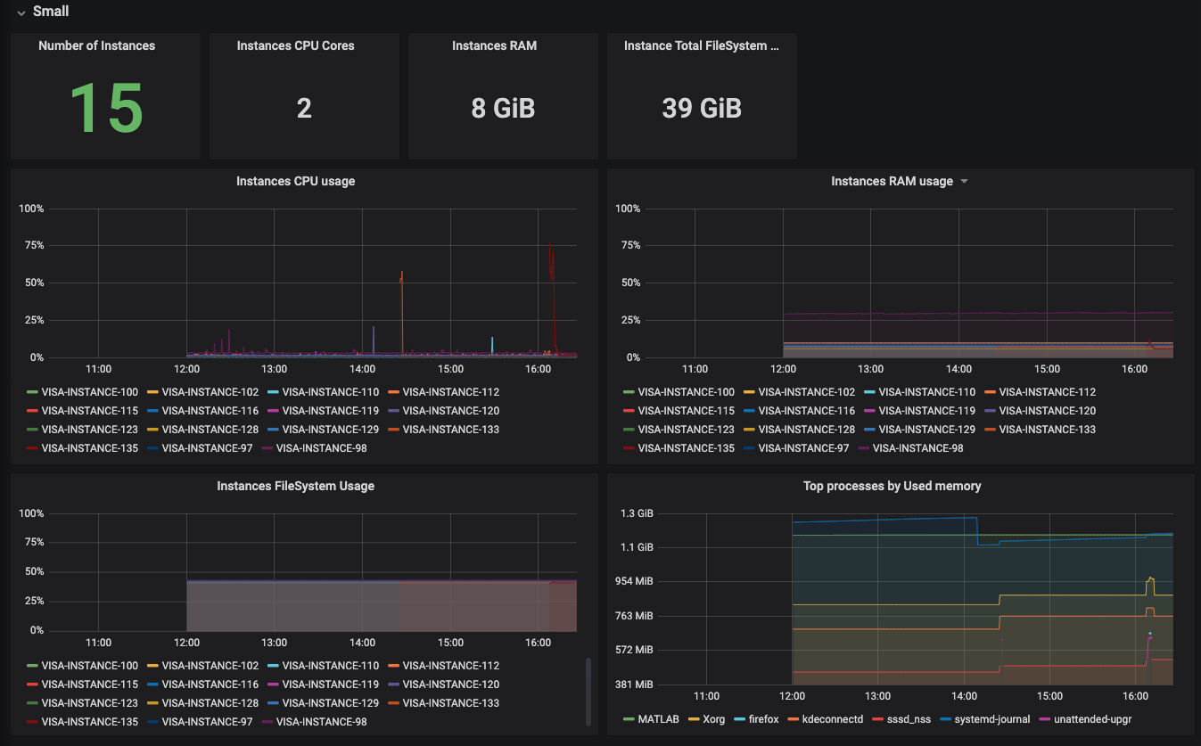
Monitoring
All instances run two prometheus processes
Node exporter and process exporter providing different insights
Prometheus server polls all instances to obtain data about:
System usage
Memory, CPU, Disk, IO
Application usage
Grafana used to visualise usage
Individual instances
Groups (flavours)
All instances
Available on visamon.ill.fr

Slide 12

Status and future development
Piloted by IN5 and D11 since January
Announced to all ILL scientists in April
Available to all ILL users
Software and infrastructure updated in May to account for remote instrument control
New compute nodes (more to be added over the coming months)
NOMAD and security groups
Scientific support user added
Getting ready for the next reactor cycle
Admin & Sci. Support interfaces to be developed
Load balancing (horizontally scale)
Integration into the PaNOSC project

Slide 13
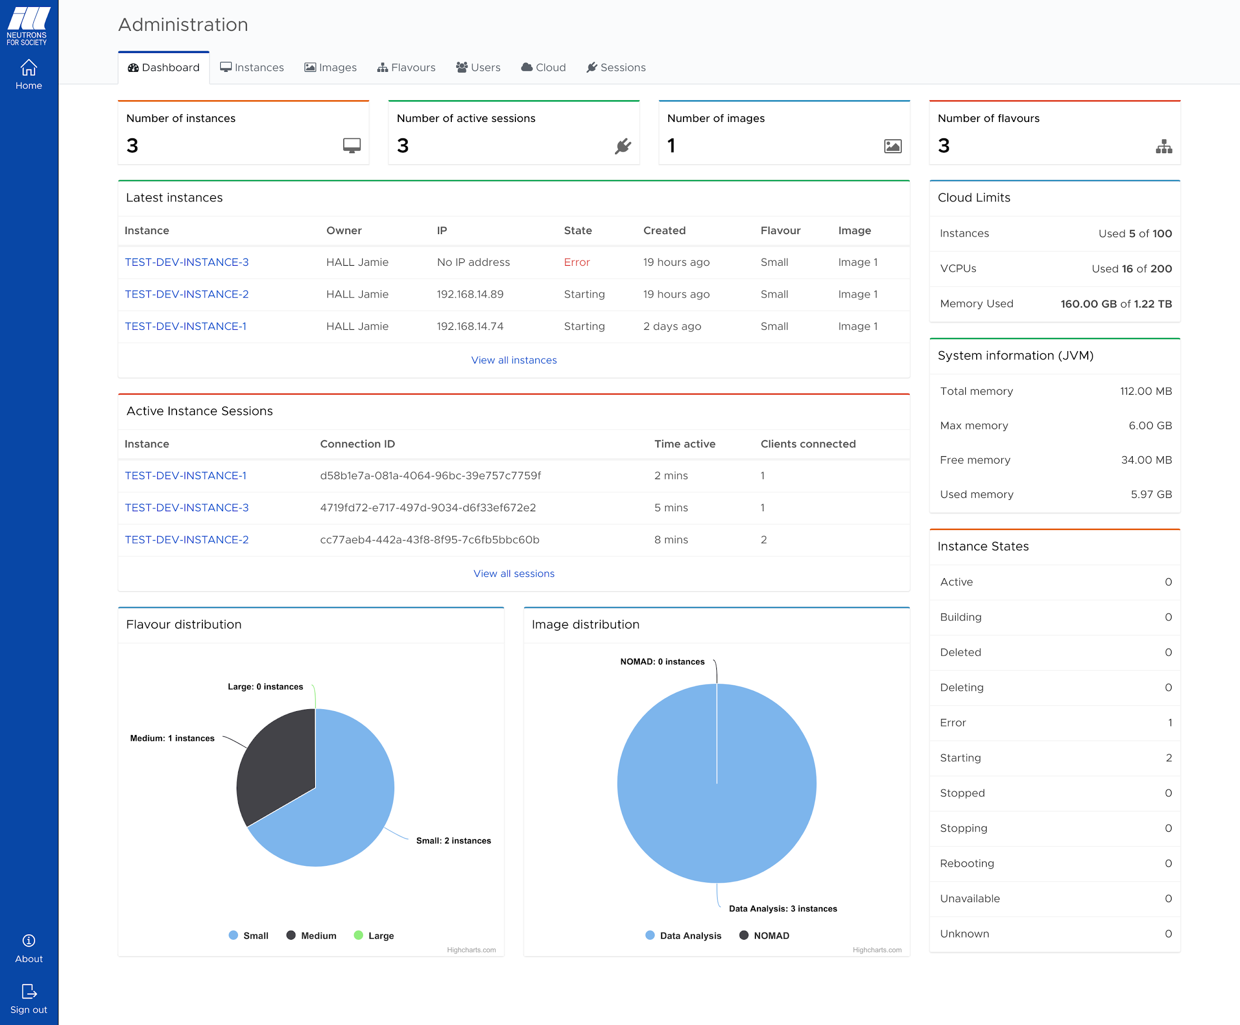
Extra
Administration interface UI
(in progress)

Slide 14

Demo

